Slide 1

DEEP NEURAL NETWORK MODULE # 4 : LINEAR NEURAL NETWORKS FOR CLASSIFICATION
DNN Team
BITS Pilani WILP

Slide 2
The instructor is gratefully acknowledging the authors who made their course materials freely available online.
This deck is prepared by Seetha Parameswaran.
Deep Learning
2 / 100

Slide 3





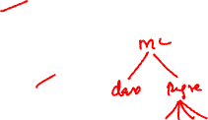
Table of Contents
1
Classification
Binary Classification
Logistic Regression
The Model: Single Neuron for Binary Classification
Binary Classification: Worked Example
Binary Classification: Evaluation Metrics
Multi-class Classification
Multi-class Classification Model
Mini-batch Stochastic Gradient Descent
Multiclass Classification: Worked Example
Making Predictions (Inference)
Multiclass Classification: Evaluation Metrics
Implementation Tips and Debugging
Summary
2
3
4
5
Deep Learning
3 / 100

Slide 4
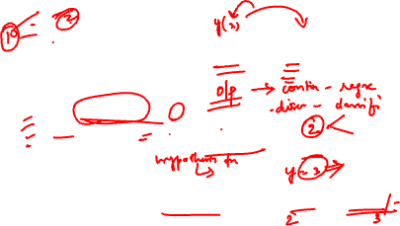
What is Classification?
Definition
Classification is a supervised learning task that predicts a discrete category or class label based on input features.
Key Characteristics:
Input: Feature vector x ∈ R^{d}
Output: Class label y ∈ {1, 2, . . . , K } (discrete)
Goal: Learn a function f : R^{d} → {1, 2, . . . , K } that assigns inputs to classes
Difference from Regression:
Regression: Predicts continuous values (e.g., price, temperature) Classification: Predicts discrete categories (e.g., spam/not spam, cat/dog)
Deep Learning
4 / 100

Slide 5

Examples of Classification Problems
1
Email Spam Detection
Input: Email text, sender information, attachments
Output: Spam or Not Spam
Medical Diagnosis
Input: Patient symptoms, test results, medical history
Output: Disease present or absent
Image Recognition
Input: Pixel values of an image
Output: Object category (cat, dog, car, etc.)
Sentiment Analysis
Input: Customer review text
Output: Positive, Negative, or Neutral
2
3
4
Deep Learning
5 / 100

Slide 6
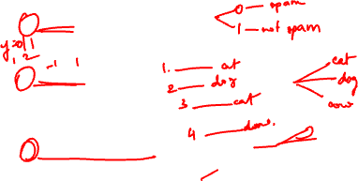
Types of Classification
Binary Classification
Two classes: y ∈ {0, 1} or {−1, +1}
Examples: Spam detection, disease diagnosis, fraud detection
Multi-class Classification
Multiple classes: y ∈ {1, 2, . . . , K } where K > 2 Examples: Digit recognition (0-9), animal classification Each example belongs to exactly one class
Multi-label Classification
Each example can belong to multiple classes simultaneously Examples: Movie genres (action + comedy), document tagging
Deep Learning
6 / 100

Slide 7



Table of Contents
Classification
Binary Classification
Logistic Regression
The Model: Single Neuron for Binary Classification
Binary Classification: Worked Example
Binary Classification: Evaluation Metrics
Multi-class Classification
Multi-class Classification Model
Mini-batch Stochastic Gradient Descent
Multiclass Classification: Worked Example
Making Predictions (Inference)
Multiclass Classification: Evaluation Metrics
Implementation Tips and Debugging
Summary
1
2
3
4
5
Deep Learning
7 / 100

Slide 8
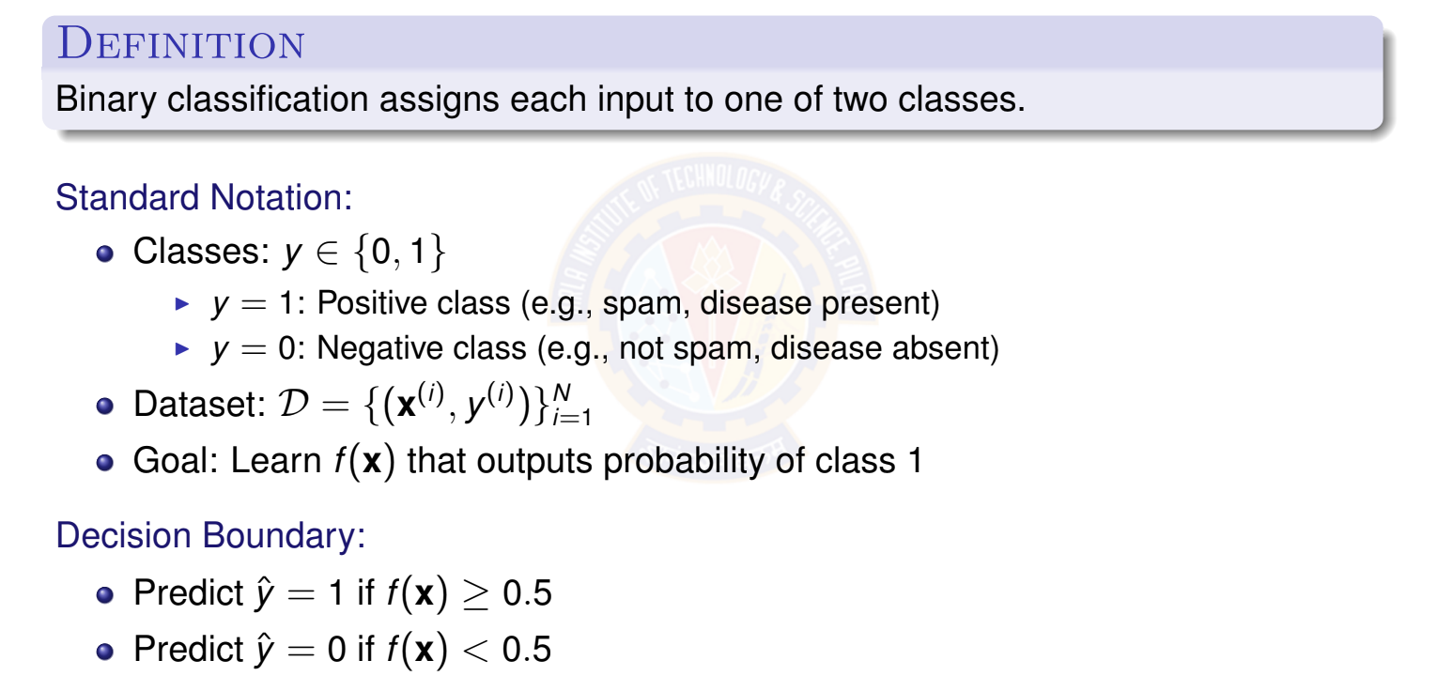
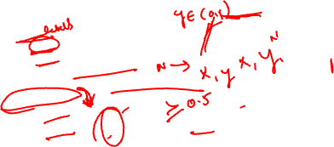
Binary Classification Problem
Deep Learning
8 / 100

Slide 9

Binary Classification: Visual Example
x₂
Decision Boundary
Region 1
The decision boundary
separates the two classes in feature space.
Region 0
x₁
Class 0
× Class 1
Deep Learning
9 / 100

Slide 10
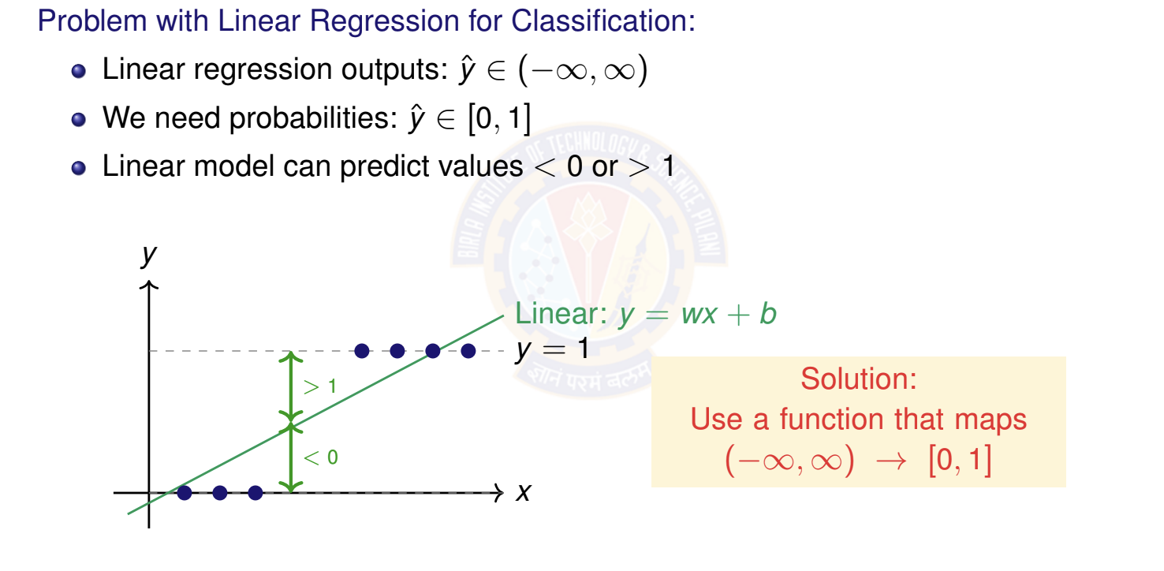
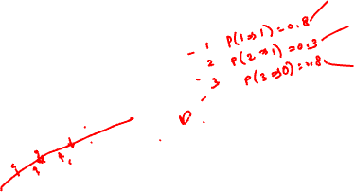
Why Not Use Linear Regression?
Deep Learning

Slide 11



Table of Contents
Classification
Binary Classification
Logistic Regression
The Model: Single Neuron for Binary Classification
Binary Classification: Worked Example
Binary Classification: Evaluation Metrics
Multi-class Classification
Multi-class Classification Model
Mini-batch Stochastic Gradient Descent
Multiclass Classification: Worked Example
Making Predictions (Inference)
Multiclass Classification: Evaluation Metrics
Implementation Tips and Debugging
Summary
1
2
3
4
5
Deep Learning

Slide 12
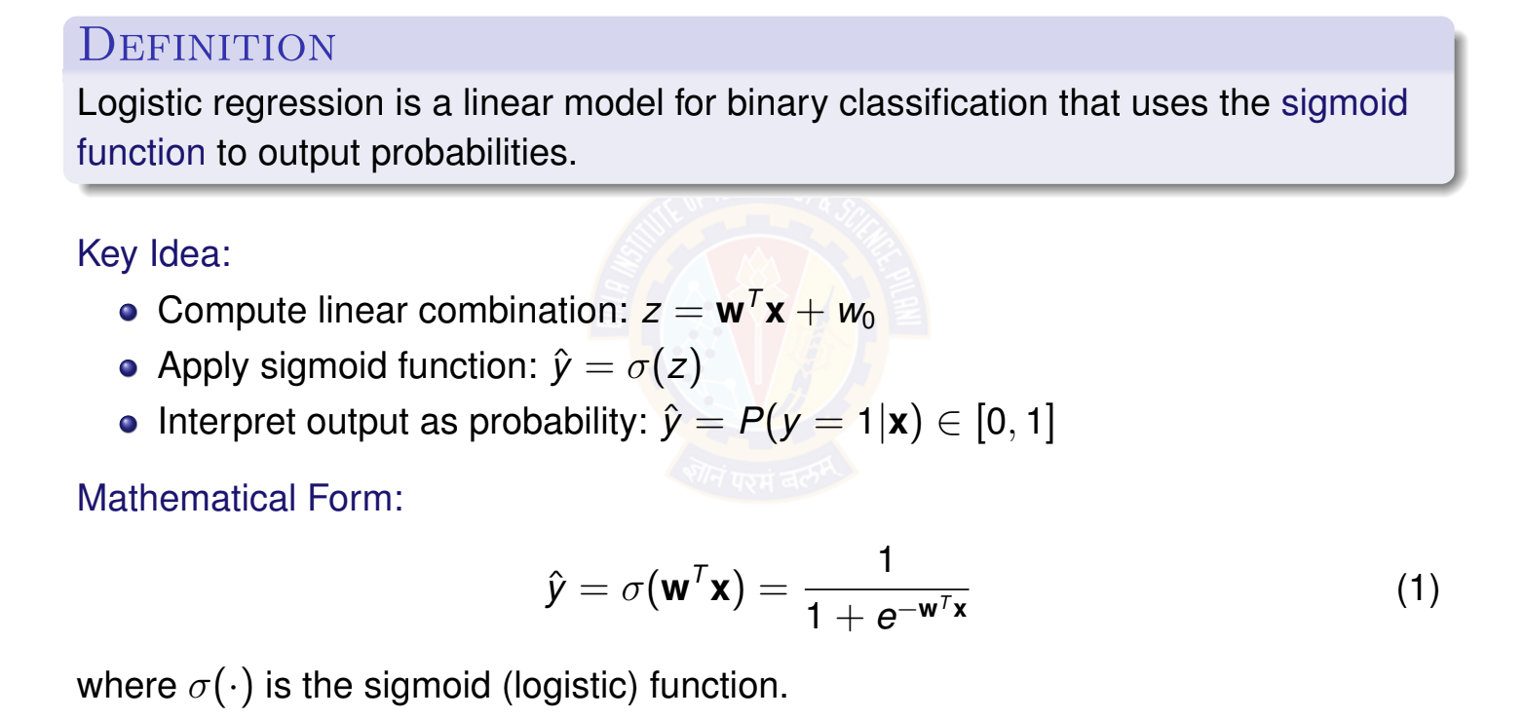
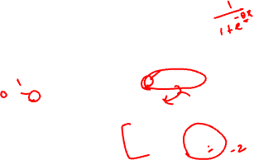
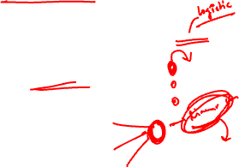

What is Logistic Regression?
Deep Learning
12 / 100

Slide 13
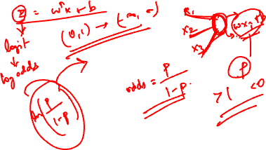

Slide 14
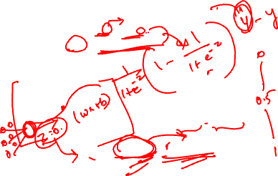
The Sigmoid Activation Function
Sigmoid (Logistic) Function: σ (z) =
1
1+e
−z
Derivative formula: σ ^{r}(z) = σ (z)(1 − σ (z))
Function
σ (z)
Derivative
σ ^{r}(z)
0.3
(0, 0.25)
1
0.2
0.5
(0, 0.5)
0.1
z
z
−5
5
−5
5
At z = 0: σ (0) = 0.5
σ^{r}(0) = 0.25
Deep Learning

Slide 15
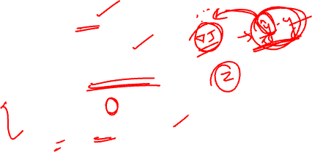
Properties of Sigmoid Function
Key Properties:
Range: σ (z) ∈ (0, 1) → perfect for probabilities!
Monotonic: Always increasing
Smooth: Differentiable everywhere
Symmetry: σ (−z) = 1 − σ (z)
Derivative: σ^{r}(z) = σ (z)(1 − σ (z))
Behavior:
When z → +∞: σ (z) → 1 (confident class 1)
When z → −∞: σ (z) → 0 (confident class 0)
When z = 0: σ (z) = 0.5 (uncertain)
The derivative property makes sigmoid ideal for gradient-based learning!
Deep Learning

Slide 16
Table of Contents
Classification
Binary Classification
Logistic Regression
The Model: Single Neuron for Binary Classification
Binary Classification: Worked Example
Binary Classification: Evaluation Metrics
Multi-class Classification
Multi-class Classification Model
Mini-batch Stochastic Gradient Descent
Multiclass Classification: Worked Example
Making Predictions (Inference)
Multiclass Classification: Evaluation Metrics
Implementation Tips and Debugging
Summary
1
2
3
4
5
Deep Learning

Slide 17
The Four Components
A complete deep learning system for classification consists of:
Data: d -dimensional input vectors and binary labels Model: Single neuron with sigmoid activation Objective Function: Binary cross-entropy loss
Learning Algorithm: Stochastic gradient descent (SGD)
1
2
3
4
Note: We use stochastic gradient descent instead of batch gradient descent for efficiency. (This is for learning purposes only.)
Deep Learning

Slide 18
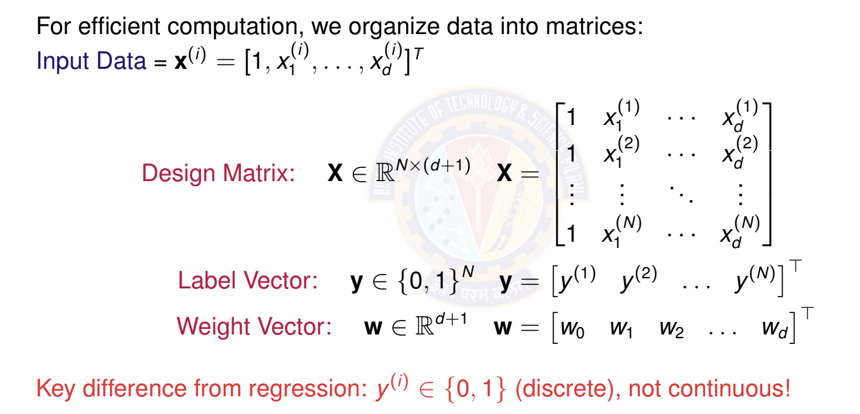

Matrix Form of Data
Deep Learning

Slide 19
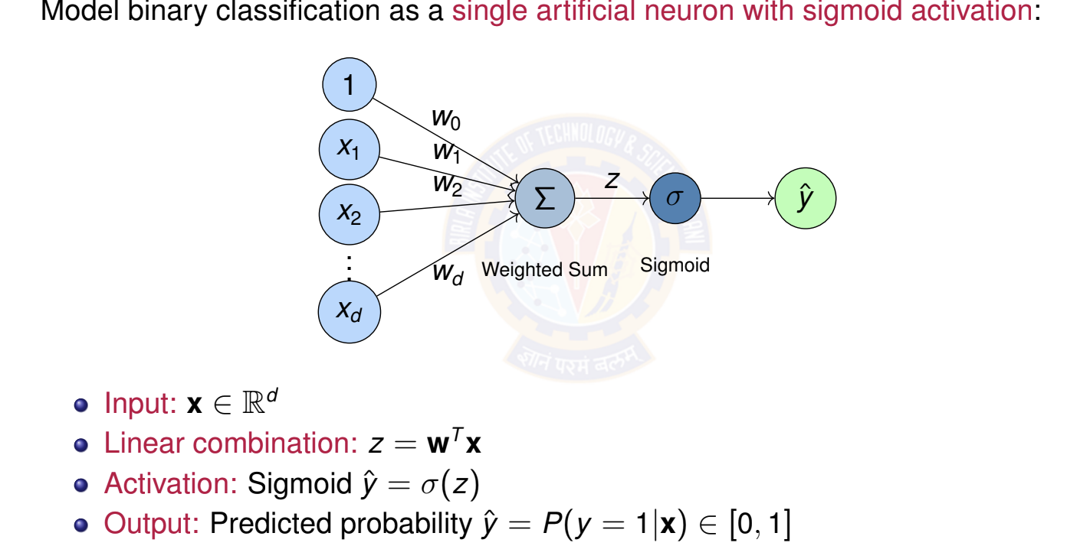
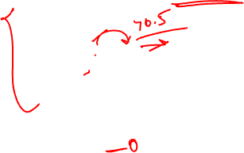
Logistic Regression as a Single Neuron
Deep Learning

Slide 20
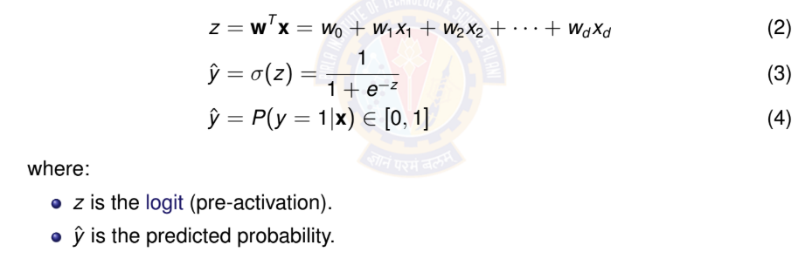

Model Prediction
Model: A single neuron computes weighted sum and applies sigmoid activation. Prediction for input x:
Deep Learning

Slide 21
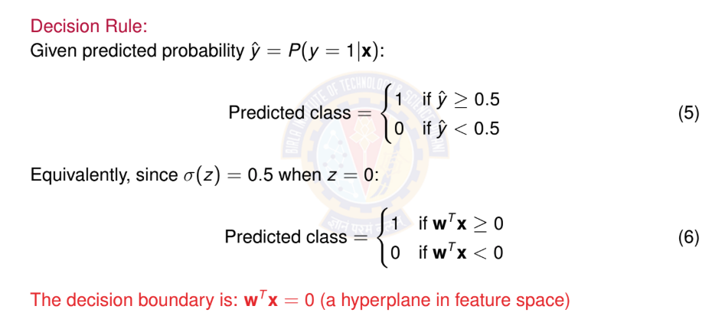
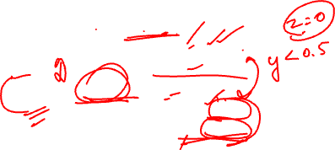
Making Predictions
Deep Learning

Slide 22
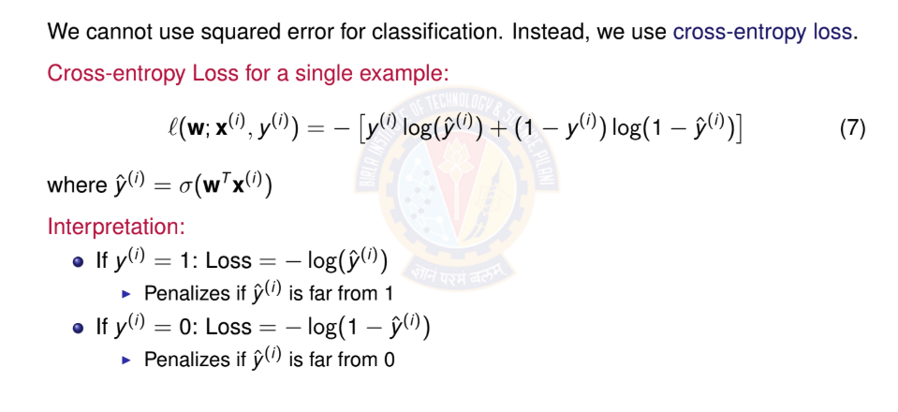
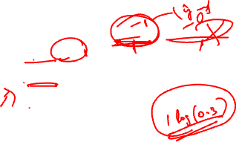
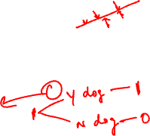
Binary Cross-Entropy Loss
Deep Learning

Slide 23
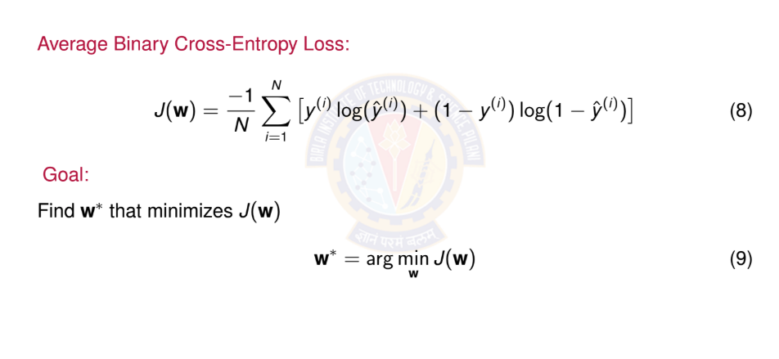
Total Loss Function
Deep Learning

Slide 24
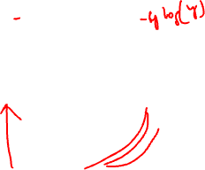
Why Cross-Entropy Loss?
Advantages:
Probabilistic interpretation: Derived from maximum likelihood estimation Appropriate for probabilities: Heavily penalizes confident wrong predictions Convex: Has a single global minimum for logistic regression
Well-behaved gradients: Works well with sigmoid activation
Loss behavior: Loss increases exponentially as prediction diverges from true label!
Loss
4
2
yˆ (prediction)
0.2 0.4 0.6 0.8
1
Deep Learning

Slide 25
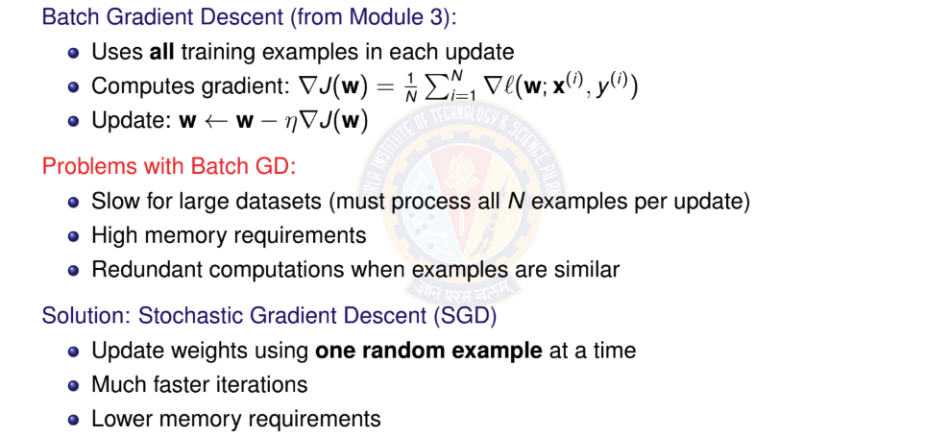
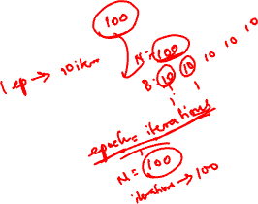
From Batch to Stochastic Gradient Descent
Deep Learning

Slide 26

Stochastic Gradient Descent (SGD)
Key Idea:
Instead of computing gradient over entire dataset, use gradient from a single ran- dom example.
SGD Update Rule: At iteration t :
Randomly select one example (x^{(i)}, y ^{(i)})
Compute gradient for this example: ∇l(w; x^{(i)}, y ^{(i)}) (noisy gradient estimate) Update weights: w^{(t +1)} = w^{(t )} − η∇l(w^{(t )}; x^{(i)}, y ^{(i)})
1
2
3
The noise in SGD actually helps escape local minima and often leads to better gen- eralization!
Deep Learning

Slide 27
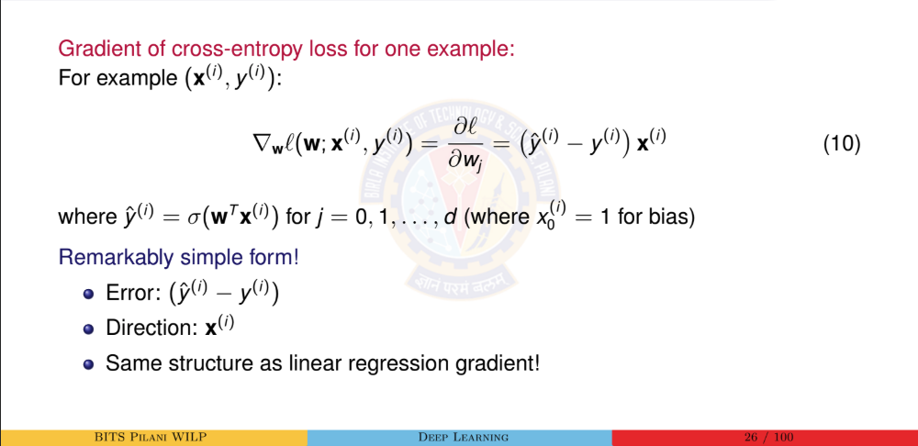
Computing the Gradient for SGD

Slide 28
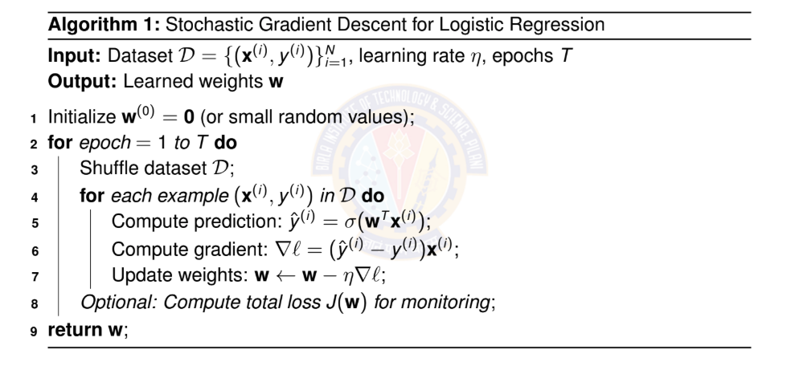

Stochastic Gradient Descent Algorithm
Algorithm 1: Stochastic Gradient Descent for Logistic Regression
Input: Dataset D = {(x^{(i)}, y ^{(i)})}^{N} , learning rate η, epochs T
i=1
Output: Learned weights w
1 Initialize w⁽⁰⁾ = 0 (or small random values);
2 for epoch = 1 to T do
Shuffle dataset D;
for each example (x^{(i)}, y ^{(i)}) in D do
3
4
5
6
7
8
Compute prediction: y^{ˆ(i)} = σ(w^{T} x^{(i)});
Compute gradient: ∇l = (y^{ˆ(i)} − y ^{(i)})x^{(i)}; Update weights: w ← w − η∇l;
Optional: Compute total loss J(w) for monitoring;
9 return w;
Deep Learning

Slide 29

SGD vs Batch GD: Visual Comparison
w₂
Batch GD
SGD
Batch GD: Smooth, deter- ministic path
SGD: Noisy, stochastic path but faster iterations
w₁
_{w}∗
Deep Learning

Slide 30

Benefits and Challenges of SGD
Benefits:
Speed: Much faster per iteration (only one example)
Memory: Can handle datasets that don’t fit in memory
Online learning: Can update model as new data arrives
Generalization: Noise helps escape sharp minima
Scalability: Works well with massive datasets
Challenges:
Noisy updates: Path to minimum is not smooth
Learning rate: More sensitive to η choice
Convergence: May oscillate near minimum
Hyperparameter tuning: Requires careful tuning
Common compromise: Mini-batch SGD
Deep Learning

Slide 31
Table of Contents
Classification
Binary Classification
Logistic Regression
The Model: Single Neuron for Binary Classification
Binary Classification: Worked Example
Binary Classification: Evaluation Metrics
Multi-class Classification
Multi-class Classification Model
Mini-batch Stochastic Gradient Descent Multiclass Classification: Worked Example Making Predictions (Inference)
Multiclass Classification: Evaluation Metrics
Implementation Tips and Debugging
Summary
1
2
3
4
5
Deep Learning

Slide 32
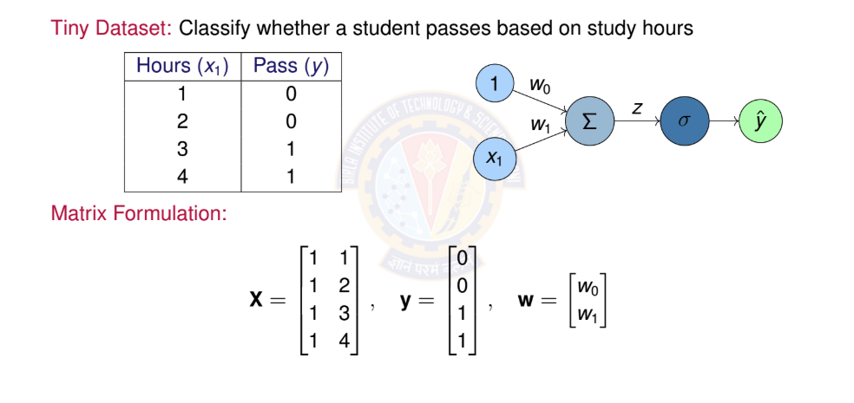

Numerical Example: Setup
Deep Learning

Slide 33
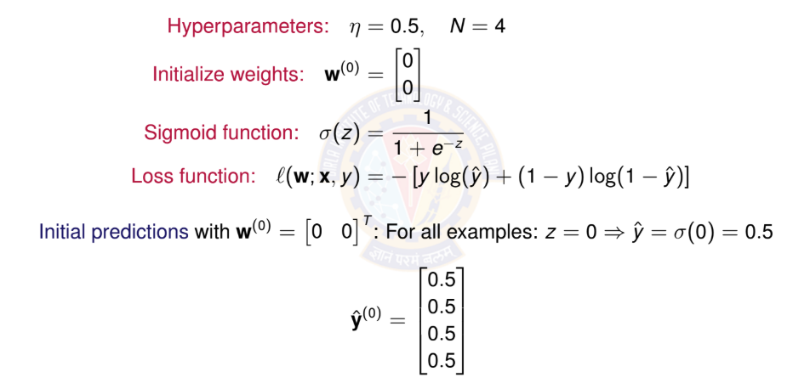
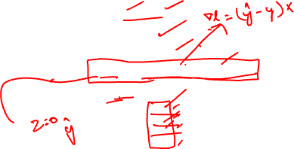
Numerical Example: Initialization
Deep Learning

Slide 34
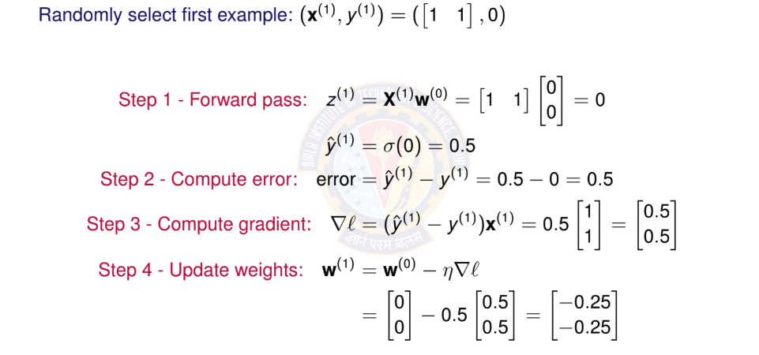
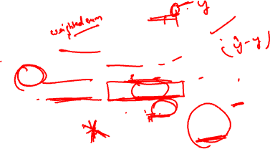
Numerical Example: First SGD Iteration
Deep Learning

Slide 35
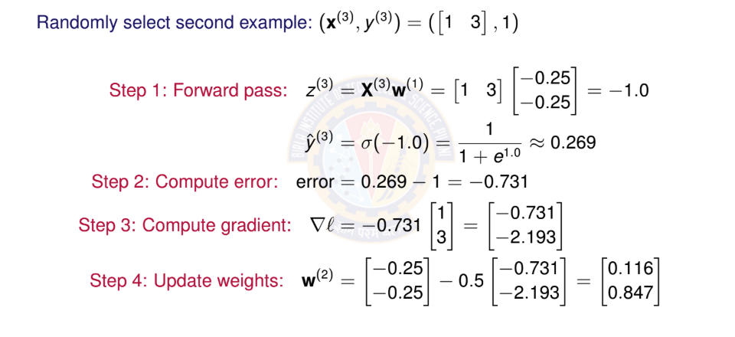
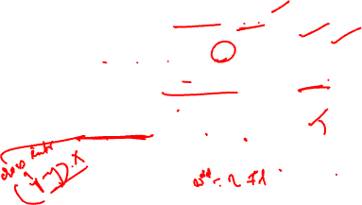
Numerical Example: Second SGD Iteration
Deep Learning

Slide 36
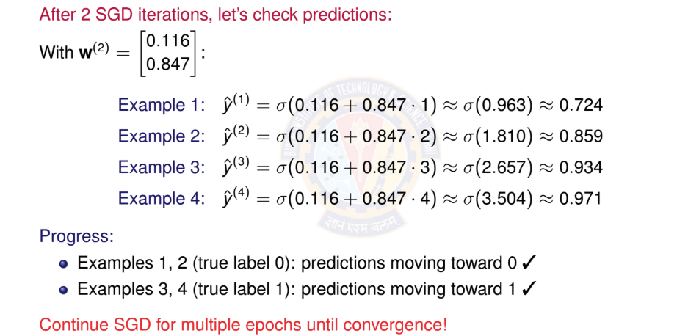
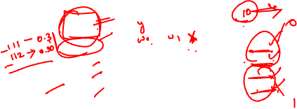
Numerical Example: Checking Progress
Deep Learning

Slide 37
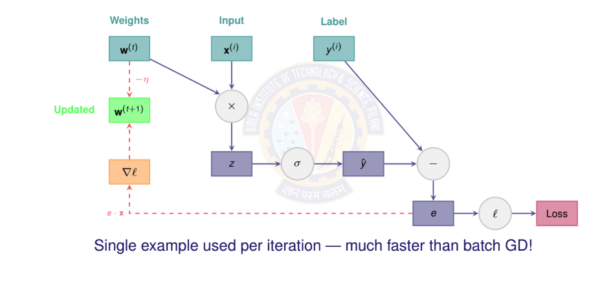
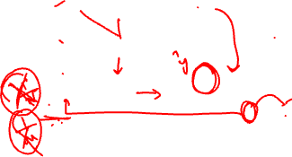
Computational Graph for One SGD Step
Deep Learning

Slide 38
Table of Contents
Classification
Binary Classification
Logistic Regression
The Model: Single Neuron for Binary Classification
Binary Classification: Worked Example
Binary Classification: Evaluation Metrics
Multi-class Classification
Multi-class Classification Model
Mini-batch Stochastic Gradient Descent Multiclass Classification: Worked Example Making Predictions (Inference)
Multiclass Classification: Evaluation Metrics
Implementation Tips and Debugging
Summary
1
2
3
4
5
Deep Learning

Slide 39
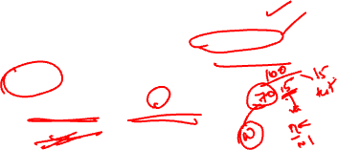
Evaluating Classification Models
Unlike regression, we need different metrics for classification. Key Questions:
How often does the model predict correctly? (Accuracy) What types of errors does it make? (Confusion Matrix)
How well does it identify positive cases? (Precision, Recall)
Data Split:
Training set: Learn weights w (typically 90-99%) Validation set: Tune hyperparameters (typically 10-15%) Test set: Final evaluation (typically 1-10%)
Always evaluate on unseen test data to measure generalization!
Deep Learning

Slide 40

Confusion Matrix
The confusion matrix shows all prediction outcomes:
Predicted
 | Positive (1) | Negative (0)
Positive (1) | True Positive (TP) | False Negative (FN)
Negative (0) | False Positive (FP) | True Negative (TN)
Actual
Definitions:
TP: Correctly predicted positive TN: Correctly predicted negative
FP: Incorrectly predicted positive (Type I error) FN: Incorrectly predicted negative (Type II error)
Deep Learning

Slide 41
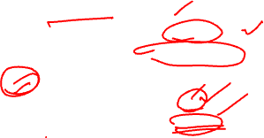
Classification Metrics I
1. Accuracy: Overall correctness
TP + TN
Accuracy =
(11)
TP + TN + FP + FN
2. Precision: Of predicted positives, how many are correct?
TP
Precision =
(12)
TP + FP
Deep Learning

Slide 42

Classification Metrics II
3. Recall (Sensitivity): Of actual positives, how many did we find?
TP
Recall =
(13)
TP + FN
4. F1 Score: Harmonic mean of precision and recall
_{F 1 = 2 ·} Precision × Recall
(14)
Precision + Recall
Deep Learning

Slide 43
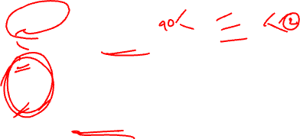
When to Use Which Metric?
Accuracy:
Use when classes are balanced
Misleading with imbalanced data! (e.g., 95% negative class)
Precision:
Important when False Positives are costly
Example: Spam detection (don’t want to mark real emails as spam)
Recall:
Important when False Negatives are costly
Example: Disease detection (don’t want to miss sick patients)
F1 Score:
Use when you need balance between precision and recall Good for imbalanced datasets
Deep Learning

Slide 44
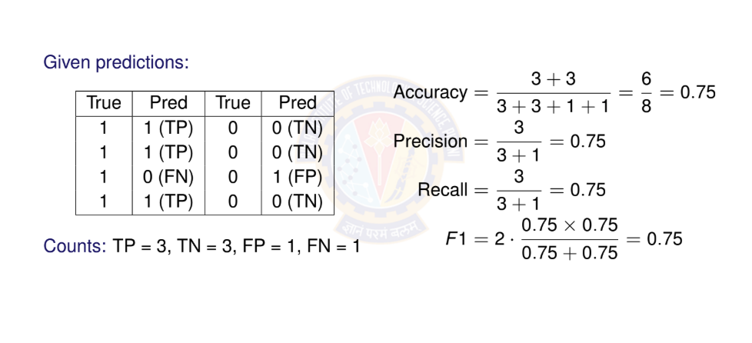
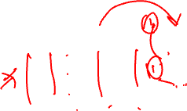
Example: Computing Metrics
Deep Learning

Slide 45
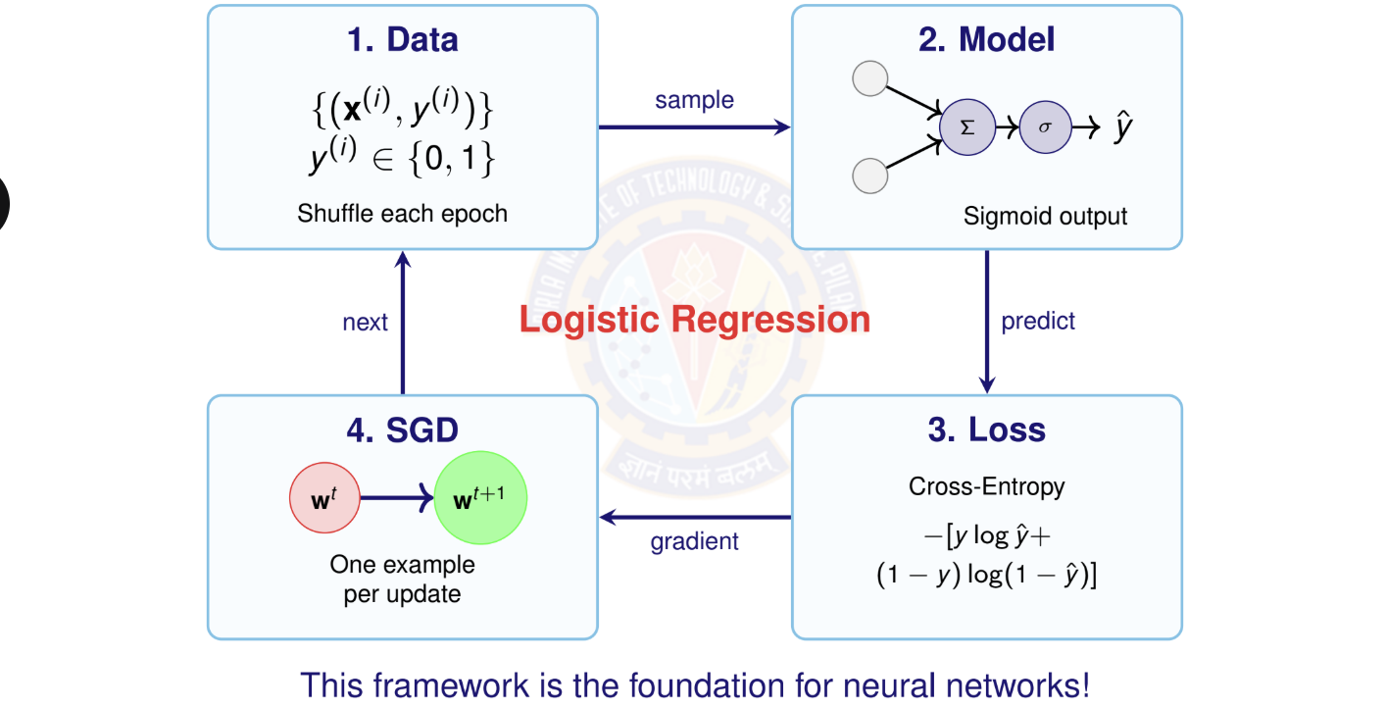

Summary: Binary Classification
Deep Learning

Slide 46
Key Takeaways
Binary classification predicts discrete categories using y ∈ {0, 1}.
Sigmoid activation σ(z) =
1
maps to probabilities [0, 1].
1+e
−z
Logistic regression = linear model + sigmoid activation.
Cross-entropy loss is the appropriate objective for classification.
Stochastic Gradient Descent (SGD) updates weights one example at a time — faster and more scalable.
Feature scaling is essential for convergence and numerical stability. Evaluation metrics: Accuracy, Precision, Recall, F1 Score, Confusion Matrix.
This framework extends naturally to multi-class classification and deep networks.
Deep Learning

Slide 47
Table of Contents
Classification
Binary Classification
Logistic Regression
The Model: Single Neuron for Binary Classification
Binary Classification: Worked Example
Binary Classification: Evaluation Metrics
Multi-class Classification
Multi-class Classification Model
Mini-batch Stochastic Gradient Descent
Multiclass Classification: Worked Example
Making Predictions (Inference)
Multiclass Classification: Evaluation Metrics
Implementation Tips and Debugging
Summary
1
2
3
4
5
Deep Learning

Slide 48
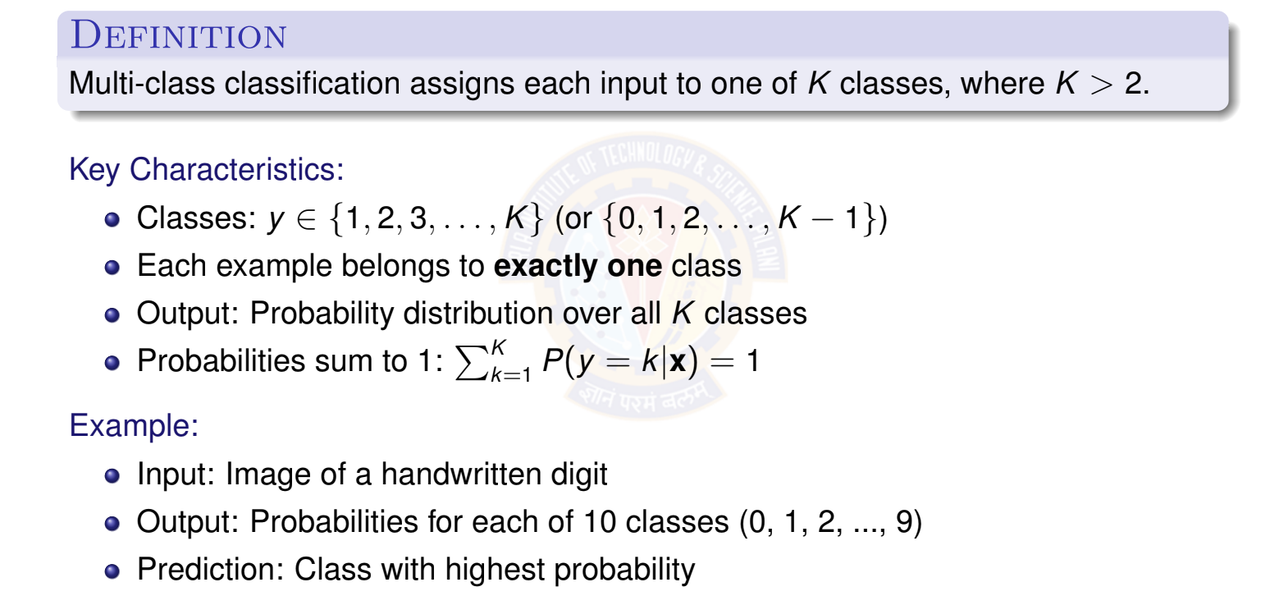
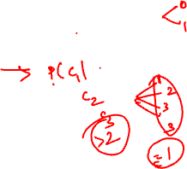
What is Multi-class Classification?
Deep Learning

Slide 49
Examples of Multi-class Classification
Handwritten Digit Recognition (MNIST)
Input: 28 × 28 pixel image
Output: One of 10 digits (0-9)
Image Classification (ImageNet)
Input: Color image
Output: One of 1000 object categories (cat, dog, car, plane, ...)
Text Classification
Input: News article text
Output: Topic category (politics, sports, technology, entertainment, business)
Speech Recognition
Input: Audio features
Output: Phoneme class (multiple phonemes in a language)
1
2
3
4
Deep Learning

Slide 50

Multi-class Classification: Visual Example
x₂
Class 1 Class 2
1
2
1
2
1
2
Key insight: We need
multiple output neu- rons (one per class) and a way to convert their outputs into a valid probability dis- tribution.
1
2
2
1
3
3
3
3
3
Class 3
x₁
Decision boundaries separate K = 3 classes in feature space.
Deep Learning

Slide 51
Table of Contents
Classification
Binary Classification
Logistic Regression
The Model: Single Neuron for Binary Classification
Binary Classification: Worked Example
Binary Classification: Evaluation Metrics
Multi-class Classification
Multi-class Classification Model
Mini-batch Stochastic Gradient Descent
Multiclass Classification: Worked Example
Making Predictions (Inference)
Multiclass Classification: Evaluation Metrics
Implementation Tips and Debugging
Summary
1
2
3
4
5
Deep Learning

Slide 52
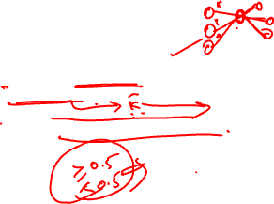
The Four Components for Multi-class
A complete multi-class classification system consists of:
Data: Input features and class labels y ∈ {1, 2, . . . , K } Model: Linear model with K output neurons (no hidden layers) Activation: Softmax function to produce probability distribution Objective Function: Categorical cross-entropy loss
Learning Algorithm: Mini-batch stochastic gradient descent
1
2
3
4
5
Note: We now use mini-batch SGD instead of single-example SGD for better effi- ciency and stability.
Deep Learning

Slide 53
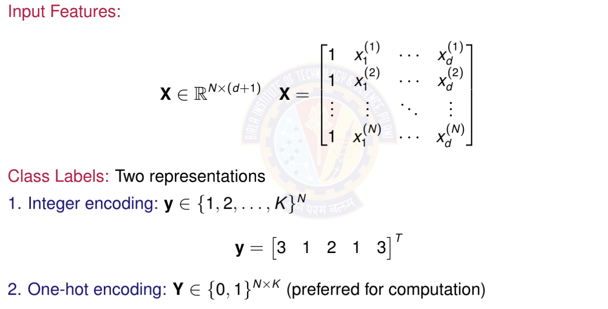

Data Representation
Deep Learning

Slide 54
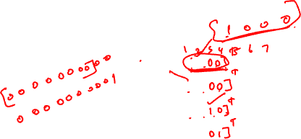
One-Hot Encoding
Definition: Convert class label to binary vector of length K
For class k : All zeros except 1 at position k
Example with K = 4 classes:
Class 1: y = [1, 0, 0, 0]^{T}
Class 2: y = [0, 1, 0, 0]^{T}
Class 3: y = [0, 0, 1, 0]^{T}
Class 4: y = [0, 0, 0, 1]^{T}
Why one-hot?
Treats all classes equally (no implicit ordering) Matches the format of softmax output probabilities Simplifies loss computation
Standard in deep learning frameworks
Deep Learning

Slide 55


Weight Matrix for Multi-class Classification
Deep Learning

Slide 56


Multi-class Model Architecture
Architecture: Multiple output neurons with softmax activation
Deep Learning

Slide 57


Linear Model: Computing Logits
Deep Learning

Slide 58


The Softmax Function
Deep Learning
57 / 100

Slide 59


Properties of Softmax
Deep Learning

Slide 60



Softmax Example: Numerical Computation
Deep Learning

Slide 61


Complete Forward Pass
Deep Learning

Slide 62



Categorical Cross-Entropy Loss
Deep Learning

Slide 63



Understanding Categorical Cross-Entropy
Deep Learning

Slide 64


Why Categorical Cross-Entropy?
Deep Learning

Slide 65
Table of Contents
Classification
Binary Classification
Logistic Regression
The Model: Single Neuron for Binary Classification
Binary Classification: Worked Example
Binary Classification: Evaluation Metrics
Multi-class Classification
Multi-class Classification Model
Mini-batch Stochastic Gradient Descent Multiclass Classification: Worked Example Making Predictions (Inference)
Multiclass Classification: Evaluation Metrics
Implementation Tips and Debugging
1
2
3
4
5
Summary
BITS Pilani WILP
Deep Learning

Slide 66

From SGD to Mini-batch SGD
Recap: Gradient Descent Variants
Batch Gradient Descent:
Uses all N examples per update
Slow but stable, accurate gradient
Stochastic Gradient Descent (SGD):
Uses 1 random example per update
Fast but noisy, unstable
Mini-batch SGD (Best of both worlds):
Uses small batch of B examples per update (1 < B << N)
Typical batch sizes: B ∈ {32, 64, 128, 256, 512}
Good balance of speed and stability
Standard in modern deep learning!
Deep Learning
65 / 100

Slide 67

Why Mini-batch SGD?
Advantages of mini-batches:
1
Computational efficiency:
⁾ Vectorized operations (matrix multiplication)
⁾ Better GPU utilization
⁾ Faster than processing examples one-by-one
Gradient estimation:
⁾ Less noisy than single-example SGD
⁾ More stable convergence
⁾ Better approximation of true gradient
Generalization:
⁾ Noise helps escape sharp minima
⁾ Often leads to better test performance
Memory efficiency:
⁾ Can handle datasets larger than memory
⁾ Load and process data in batches
2
3
4
Deep Learning

Slide 68


Mini-batch SGD: Key Concepts
Deep Learning

Slide 69


Computing Gradients for Mini-batch
Deep Learning

Slide 70

Mini-batch SGD Update Rule
Deep Learning

Slide 71


Mini-batch SGD Algorithm
Deep Learning

Slide 72

Choosing Batch Size
Batch Size | Advantages | Disadvantages
Small (32-64) | Fast iterations More updates per epoch Better generalization Escapes sharp minima | Noisy gradients Unstable training Poor GPU utilization
Medium (128-256) | Good balance Stable training Good GPU usage Standard choice | May need tuning
Large (512-1024) | Stable gradients Better GPU utilization Faster per-epoch time | Slow convergence May generalize worse More memory
Deep Learning

Slide 73
Table of Contents
Classification
Binary Classification
Logistic Regression
The Model: Single Neuron for Binary Classification
Binary Classification: Worked Example
Binary Classification: Evaluation Metrics
Multi-class Classification
Multi-class Classification Model
Mini-batch Stochastic Gradient Descent
Multiclass Classification: Worked Example
Making Predictions (Inference)
Multiclass Classification: Evaluation Metrics
Implementation Tips and Debugging
Summary
1
2
3
4
5
Deep Learning

Slide 74



Numerical Example: Setup
Deep Learning

Slide 75



Numerical Example: Data Representation
Deep Learning

Slide 76




Numerical Example: First Mini-batch (Examples
Deep Learning

Slide 77



Numerical Example: Softmax Computation
Deep Learning

Slide 78



Numerical Example: Gradient and Update
Deep Learning

Slide 79


Numerical Example: Weight Update
Deep Learning

Slide 80


Computational Graph for Mini-batch Forward
Deep Learning

Slide 81
Table of Contents
Classification
Binary Classification
Logistic Regression
The Model: Single Neuron for Binary Classification
Binary Classification: Worked Example
Binary Classification: Evaluation Metrics
Multi-class Classification
Multi-class Classification Model
Mini-batch Stochastic Gradient Descent
Multiclass Classification: Worked Example
Making Predictions (Inference)
Multiclass Classification: Evaluation Metrics
Implementation Tips and Debugging
Summary
1
2
3
4
5
Deep Learning

Slide 82


Inference: Making Predictions
Deep Learning

Slide 83


Inference Example
Deep Learning

Slide 84
Table of Contents
Classification
Binary Classification
Logistic Regression
The Model: Single Neuron for Binary Classification
Binary Classification: Worked Example
Binary Classification: Evaluation Metrics
Multi-class Classification
Multi-class Classification Model
Mini-batch Stochastic Gradient Descent
Multiclass Classification: Worked Example
Making Predictions (Inference)
Multiclass Classification: Evaluation Metrics
Implementation Tips and Debugging
Summary
1
2
3
4
5
Deep Learning

Slide 85


Evaluation Metrics for Multi-class
Deep Learning

Slide 86

Confusion Matrix for Multi-class
Example: 3-class confusion matrix
Predicted
 | Class 1 | Class 2 | Class 3
Class 1 | 45 | 3 | 2 7
Class 2 | 5 2 | 38
Class 3 |  | 4 | 44
Actual
Interpretation:
Diagonal (green): Correct predictions (45, 38, 44) Off-diagonal (red): Misclassifications
Row sums: Total actual examples per class (50, 50, 50) Column sums: Total predicted examples per class
Accuracy: (45 + 38 + 44)/150 = 0.847 or 84.7%
Deep Learning

Slide 87

Per-class Metrics
For each class k , compute:
Precision for class k : Of all predictions for class k , what fraction were correct?
TP_{k}
Precision_{k} =
(32)
TP_{k} + FP_{k}
Recall for class k : Of all actual class k examples, what fraction did we identify?
TP_{k}
Recall_{k} =
(33)
TP_{k} + FN_{k}
F1 Score for class k :
_{= 2 ·} Precision_{k} × Recall_{k}
F 1
(34)
k
Precision_{k} + Recall_{k}
Deep Learning

Slide 88


Averaging Strategies
Deep Learning

Slide 89


Top-K Accuracy
For problems with many classes (e.g., ImageNet with 1000 classes): Top-K Accuracy: Correct if true class is in top K predictions
Example: Image classification with 1000 classes
Top-1 accuracy: Is the highest probability class correct? Top-5 accuracy: Is the true class in the top 5 predictions?
Why useful?
More forgiving metric for large K
Captures whether model has correct class among top candidates Standard in ImageNet challenge
Deep Learning

Slide 90


Summary: Multiclass Classification
Deep Learning

Slide 91
Table of Contents
Classification
Binary Classification
Logistic Regression
The Model: Single Neuron for Binary Classification
Binary Classification: Worked Example
Binary Classification: Evaluation Metrics
Multi-class Classification
Multi-class Classification Model
Mini-batch Stochastic Gradient Descent
Multiclass Classification: Worked Example
Making Predictions (Inference)
Multiclass Classification: Evaluation Metrics
Implementation Tips and Debugging
Summary
1
2
3
4
5
Deep Learning

Slide 92


Implementation Tips
Deep Learning

Slide 93


Debugging Checklist
Deep Learning

Slide 94
Table of Contents
Classification
Binary Classification
Logistic Regression
The Model: Single Neuron for Binary Classification
Binary Classification: Worked Example
Binary Classification: Evaluation Metrics
Multi-class Classification
Multi-class Classification Model
Mini-batch Stochastic Gradient Descent
Multiclass Classification: Worked Example
Making Predictions (Inference)
Multiclass Classification: Evaluation Metrics
Implementation Tips and Debugging
Summary
1
2
3
4
5
Deep Learning

Slide 95

Activation Functions
Deep Learning

Slide 96

Loss Functions
Deep Learning

Slide 97

Gradient Descent Variants
Deep Learning

Slide 98

Comparison of Linear models
Deep Learning

Slide 99
Recap: Binary Classification
Logistic Regression
Key insight: Sigmoid maps linear combination to probability; optimized by minimiz- ing cross-entropy loss.
Problem: Classify into two classes: y ∈ {0, 1} Model: Single neuron with sigmoid activation Output: Probability y^{ˆ} = P(y = 1|x) ∈ [0, 1] Loss: Binary cross-entropy
Training: Stochastic Gradient Descent (SGD)
x₁
Σ
z
σ
y^{ˆ}
x₂
Class 0 or 1
Deep Learning

Slide 100

Recap: Multi-class Classification
Deep Learning
100 / 100

Slide 101

References
Zhang, A., Lipton, Z. C., Li, M., & Smola, A. J. (2023). Dive into Deep Learning. Cambridge University Press. Chapter 4 (Linear Neural Networks for Classification). https://d2l.ai/
Goodfellow, I., Bengio, Y., & Courville, A. (2016). Deep Learning. MIT Press. Chapter 6 (Deep Feedforward Networks). https://www.deeplearningbook.org/
Bishop, C. M. (2006). Pattern Recognition and Machine Learning. Springer. Chapter 4 (Linear Models for Classification).
Murphy, K. P. (2022). Probabilistic Machine Learning: An Introduction. MIT Press. Chapter 10 (Logistic Regression). https://probml.github.io/pml-book/
Deep Learning

